Slide 1

Ultrasonic Sensors
May 2019

Slide 2
Goals
Success Criteria
Understand the meaning of ultrasound
Generate sound on an app
Build ultrasound circuits with an Arduino
Able to explain what ultrasound is
Working ultrasonic circuits

Slide 3
What is Ultrasonic Sound
Ultrasound is sound waves with frequencies higher than the upper audible limit of human hearing. Ultrasound is not different from "normal" sound in its physical properties, except that humans cannot hear it. This limit varies from person to person and is approximately 20 kilohertz in healthy young adults.
~Wikipeda~

Slide 4
Generate some sound
Just to get an idea of what ultrasound ‘sounds’ like (note that you can’t hear it!), install an app for your iPhone or Android and generate some sounds just to get an idea of how high the ultrasonic range is:
https://itunes.apple.com/us/app/signal-generator-audio-test-tone-utility/id543661843?mt=8
http://www.avevt.com/news/35-test-tone-generator-for-iphone-ipad-android

Slide 5
Ultrasound in Nature
Many bats emit echolocation calls usually by contracting their larynx (voice box). These calls are usually ultrasonic – with a range of 20-200kHz.
Do you know where human hearing tops out?
Higher frequency calls means more detailed info such as size, range, position, speed and direction of their prey! Pretty detailed information!
In terms of loudness, the sounds are between 50dB and 150dB

Slide 6
Ultrasound in Medicine
Ultrasound is used during pregnancy to check the baby’s development and to help pick up any abnormalities such as Down syndrome.
Since the procedure can’t produce high quality images, any suspected abnormalities need to be confirmed with other tests.
The ultrasound scan isn’t 100 per cent accurate, but the advantages of the test are that it’s non-invasive, painless and safe for both mother and unborn baby.

Slide 7
Ultrasonic Sensors – the HC-SR04
Working Voltage: DC 5V.
Working Current: 15mA.
Working Frequency: 40Hz.
Max Range: 4m.
Min Range: 2cm.
Measuring Angle: 15 degree.
Trigger Input Signal: 10µS TTL pulse.
Echo Output Signal Input TTL lever signal and the range in proportion.

Slide 8
Ultrasonic Sensors in Autonomous Vehicles
With 8 ultrasonic sensors, the car on the right could build up a virtual picture of its surroundings and choose the right direction to go next!

Slide 9
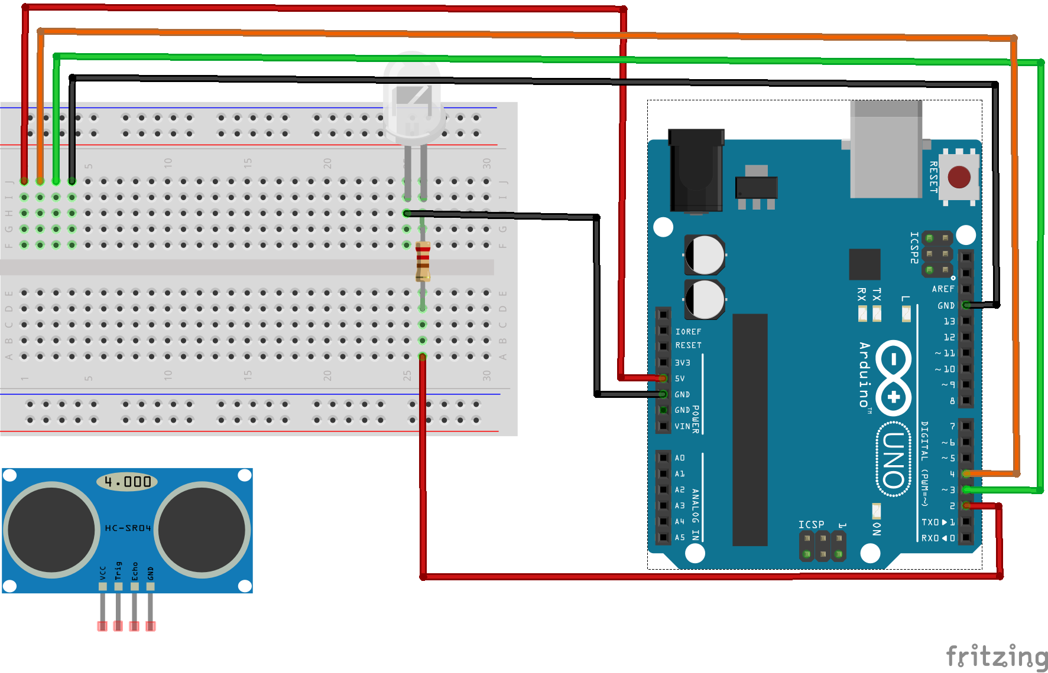
Wiring up the HC-SR04 (1)

Slide 10
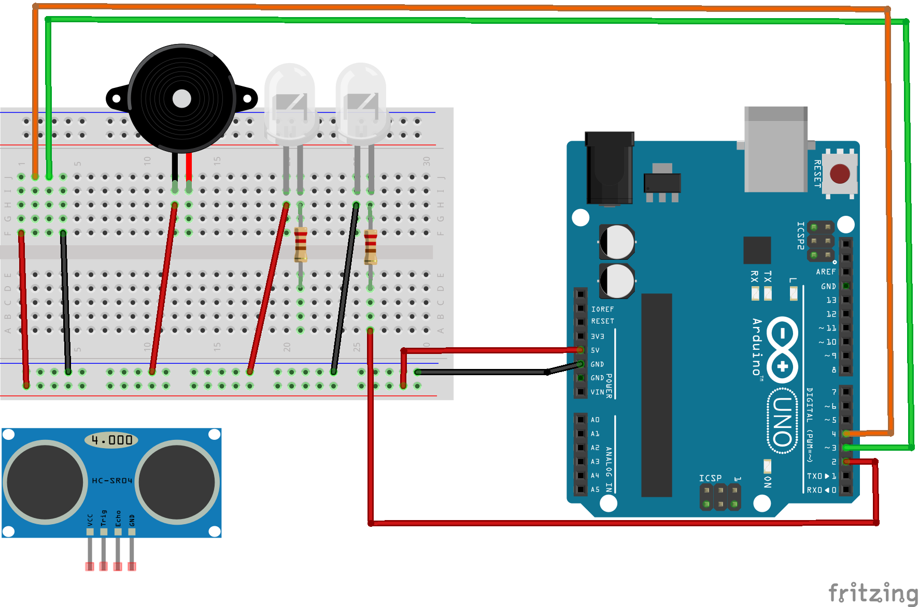
Wiring up the HC-SR04 (2)
The following circuit diagram shows an unfinished circuit which extends the idea that you put together in the first circuit.
The idea is that there are various distance ranges that trigger different LEDs or the buzzer depending on how serious the breach is.
NOTE: We have created a 5v and GND rail so that the entire row is set to either 5v or GND which helps us plug lots of components in.

